Slide 1
Higher Educational Program Proposal
Ashish Gupta Jennifer Nielsen
Monica Walters Satinder Sondhi

Slide 2



University Unit has the opportunity to fund a new non-degree program for 55 and older community
The total budget available for allocation to this program is $500,000
Expected profits over a typical period of 5-years are $75,000 per year.
Consultants provided typical trends of the market for Demand and Advertising.
Should I?
How much?
What distribution?
Risks?
Notes:
This enrollment typically adds an additional benefit to the University as 15% of non-degree students eventually become paying students for degree programs.

Slide 3
INFLUENCE CHART

Slide 4
BUSINESS CASE CONSTRAINTS
Enrollment maximum for program is 600
Annual fee norm for like programs is $1,500
Next year advertising expenditures cannot exceed 80% current year available balance
Other Interlinked constraints that impact costs and profits
ADVERTISING & RECRUITMENT
Funds Availability
FEE
MATERIAL & LAUNCHING

Slide 5
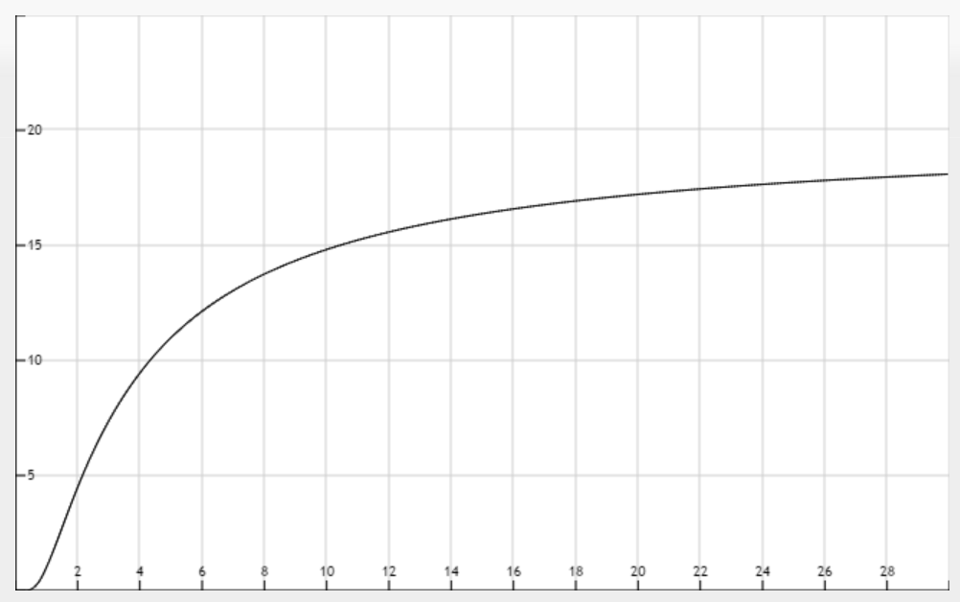
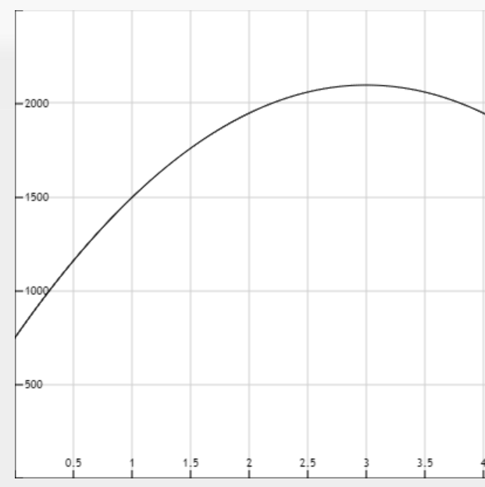


Trends from Consultants
Response Rate vs Advertising Expenditure
Popularity of Program vs Time
$$Y={20}^{\left(1−\frac{1}{x}\right)}$$
$Y=150(5+6x−x^{2})$,

Slide 6
SPREADSHEET ENGINEERING
Decisions
Parameters
Advertisement Expenditure
Budget Allocation
Fixed Tuition
Fixed Cost
Variable Cost
Functional

Slide 7
MANAGERIAL INSIGHTS
Recommend to reduce allocated budget since no improvements on profit observed after a certain amount of expenditure.
No Risk Cover
Analyze flexibility of Student-teacher Ratio
Increase in maximum Student-Teacher cap can multiply profits. Thus, it’s important to look upon the flexibility of the same.
Cap No. of students
Optimal Budget Allocation over years is totally front loaded whereas all risks are ahead of time. Zero budget requirement from year 3. Thus, against the expectations, no risks are covered through distribution of budget over years.
Reduce Allocation Budget
I
Maximum ROI – 100%
ing
dell
Total Admissions have to be capped as per “s-t” ratio in order to realize optimized profits
Mo
Maximum ROI from this investment is 100% in a period of five years.

Slide 8
BUSINESS CASE FINDINGS
Though maximum popularity of the program is achieved in the 4th year, maximum spending in expenditures are realized in 2nd year, thus, limiting the maximum no. of admissions
An average profit of around $46,000 (half of expected) is expected every year after discounting to first year
Increasing maximum student-teacher ratio by 10 causes a whopping 61% increase in profit, almost double the regular proportionate expectation.
Random fluctuations of profit with market behavior are expected to be in the range $158,000 to $403,000 with a 90% confidence.

Slide 9
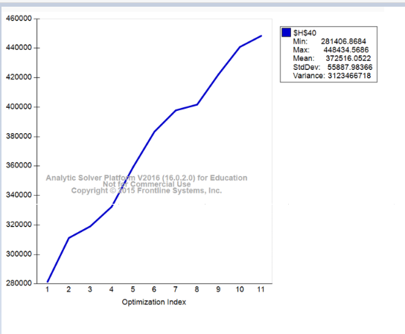
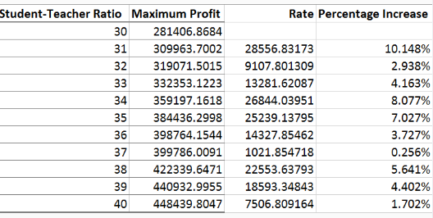
IMPACT OF MAXIMUM STUDENT-TEACHER RATIO CAP ON PROFIT RATE
Business Profit Increase with Max student teacher ratio cap
Business Profit Rate Increase with student teacher ratio cap

Slide 10
CONCLUSION
02
As per current situation, we are far from capturing the demand/market to its full potential. Internal constraints – “S-T” ratio, space, etc. proved to be the limiting factor. Thus there is a lot of scope for improvement internally.
Modelling suggests that benefits reaped from this endeavor are almost half the expectations. However, Budget required is also the half of the expected initial budget. Thus, proving to be a low scale business
01
02
Inflation is more likely to affect positively. However, unexpected fluctuations in the demand may effect severely.
The model is wrong……but it may be useful!

Slide 11
QUESTIONS?
Thank You!

